Slide 1
URL for presentation: https://youtu.be/oT11nZ_ZLwA

Slide 2

Bitcoin Core
Group 6 Presented by Anthony Zhou, Chang Xu

Slide 3
Derivation Process
analyze for shortcomings, consider architectural style
from dependency graph, sketch concrete architecture graph
comparative analysis between the final concrete graph and the conceptual graph

Slide 4
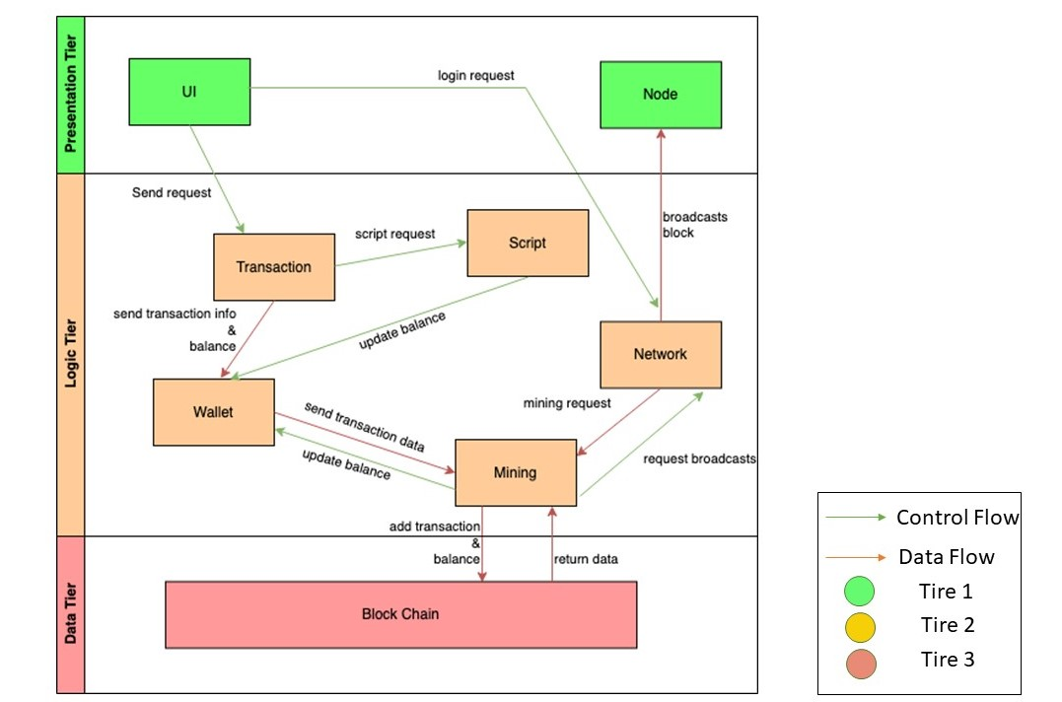
Conceptual Architecture
Figure 2. Conceptual Architecture

Slide 5
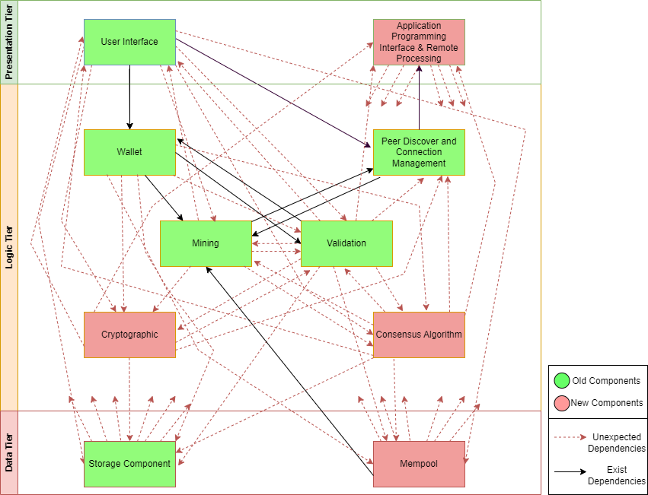
High-level Concrete Architecture
Figure 1. Top-Level Concrete Architecture

Slide 6
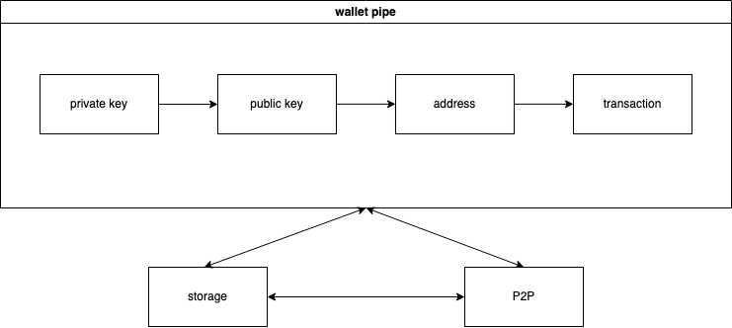
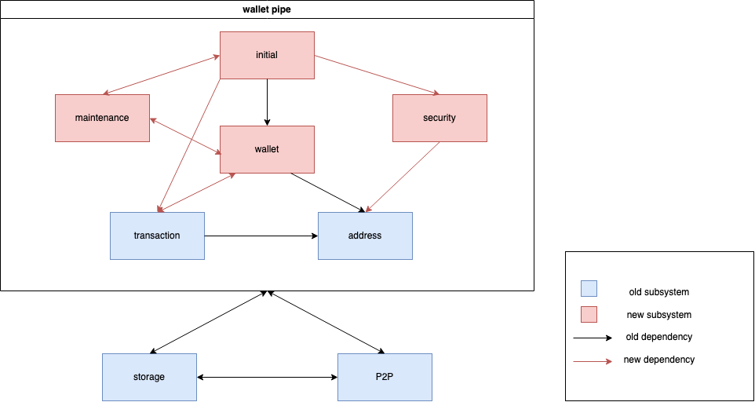
Figure 2. Conceptual Architecture of Wallet
Figure 3. Concrete Architecture of Wallet
Wallet

Slide 7
Reflexion analysis
- Storage ↔ Cryptographic Libraries - Wallet → Mining and Mempool

Slide 8
Reflexion analysis (Cont.)
- Wallet ↔ Maintenance, Transaction
- Initial ↔ Maintenance
- Security → Address

Slide 9
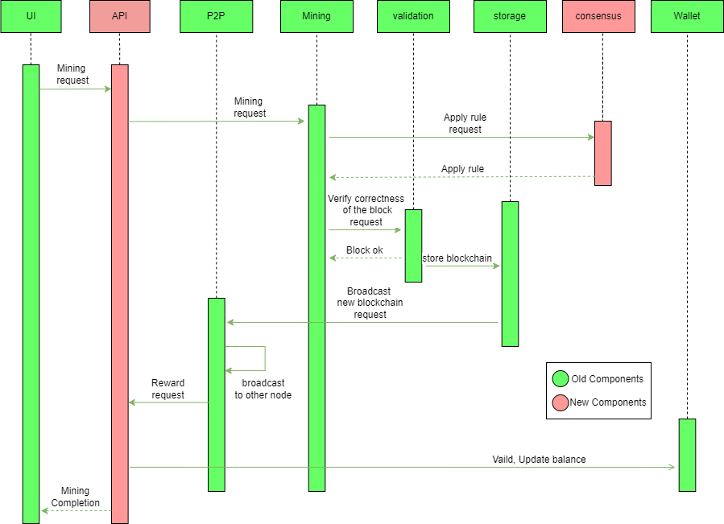
USE CASE: Solo-Mining
Figure 4. Transaction sequence diagram

Slide 10

- Initial and Maintenance
- process multiple transactions
Concurrency
- consensus among network nodes
- peer-to-peer network

Slide 11

Lesson Learned and Limitation
Conceptual Architecture vs Concrete Architecture
Modular Design
File Categorization

Slide 12

Thank you !

